Slide 1

COMS W4111: Introduction to Databases, Section 002, Spring 2021
Lecture 1: Introduction, Course Overview, Foundational Concepts
Donald F. Ferguson (dff@cs.columbia.edu)
© Donald F. Ferguson, 2021

Slide 2

We will start in a couple of minutes
2 | COMS W4111_002_2021_1: Lecture 1: Introduction, Course Overview, Foundational Concepts © Donald F. Ferguson, 2021

Slide 3
Data Warehouse
Data Lake
3 | Introduction to Databases (F20): Lecture 12 – Big Data and Analytics

Slide 4
Enterprise Information Integration

Slide 5
Data Warehouse and Data Lake

Slide 6
Extract Transform Load Concepts and Example
6 | Introduction to Databases (F20): Lecture 12 – Big Data and Analytics

Slide 7

ETL Concepts
7 | Introduction to Databases (F20): Lecture 12 – Big Data and Analytics

Slide 8
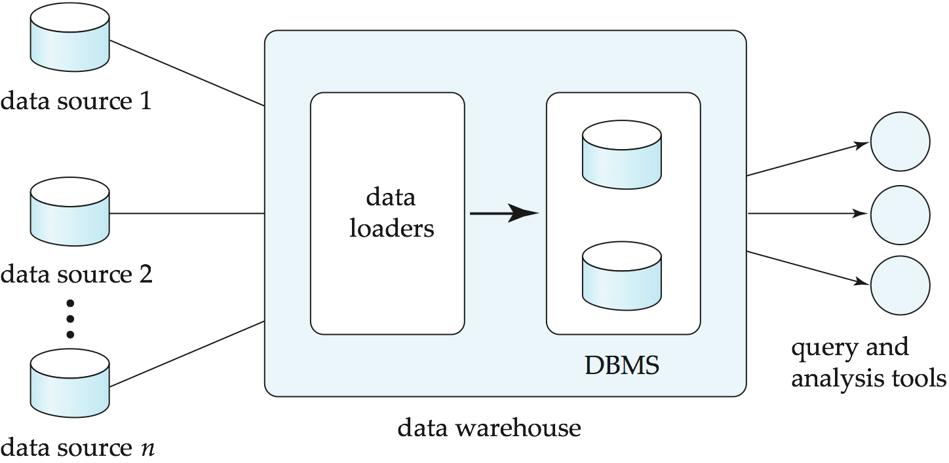
Data Warehousing

Slide 9
Overview (Cont.)
Common steps in data analytics
Gather data from multiple sources into one location
Data warehouses also integrated data into common schema
Data often needs to be extracted from source formats, transformed to common schema, and loaded into the data warehouse
Can be done as ETL (extract-transform-load), or ELT (extract-load-transform)
Generate aggregates and reports summarizing data
Dashboards showing graphical charts/reports
Online analytical processing (OLAP) systems allow interactive querying
Statistical analysis using tools such as R/SAS/SPSS
Including extensions for parallel processing of big data
Build predictive models and use the models for decision making

Slide 10
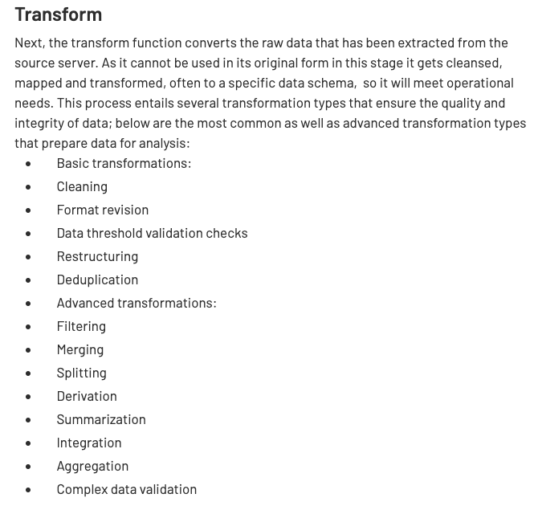
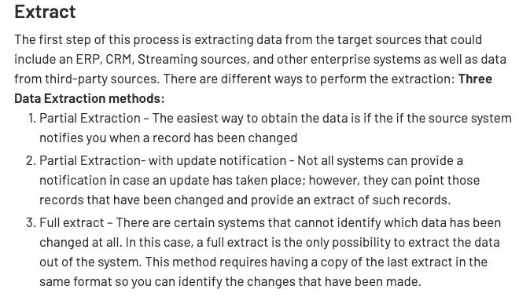
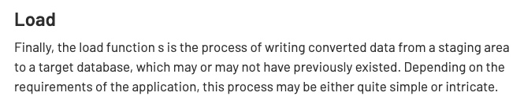
ETL Concepts
https://databricks.com/glossary/extract-transform-load

Slide 11
Spark (and ETL)
11 | Introduction to Databases (F20): Lecture 12 – Big Data and Analytics

Slide 12
MapReduce
MapReduce is a data flow program with relatively simple operators on the data set.
op1
op2
op3
With each operator implemented in parallel on multiple nodes for performance.
What is we want more complex “operators?”

Slide 13
Algebraic Operations
Current generation execution engines
natively support algebraic operations such as joins, aggregation, etc. natively.
Allow users to create their own algebraic operators
Support trees of algebraic operators that can be executed on multiple nodes in parallel
E.g. Apache Tez, Spark
Tex provides low level API; Hive on Tez compiles SQL to Tez
Spark provides more user-friendly API

Slide 14
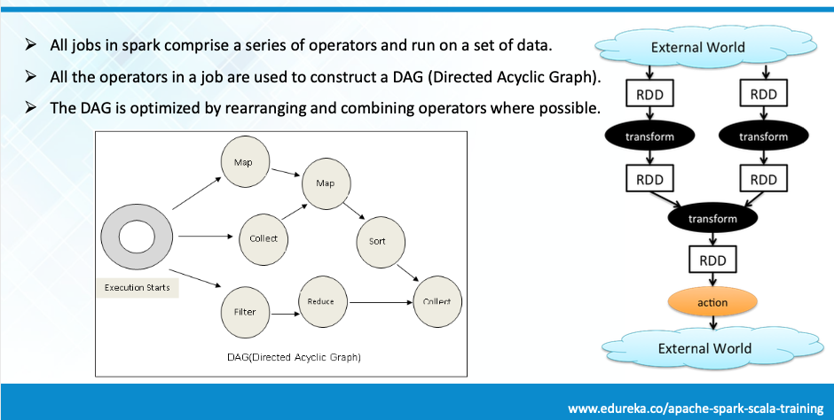
Spark

Slide 15
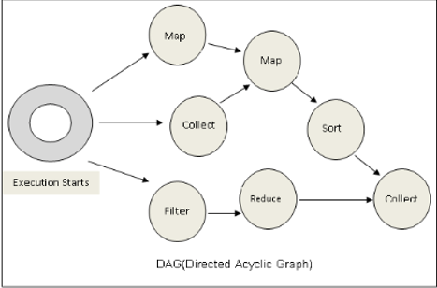
Spark
Conceptually similar to query evaluation graph, but ...
You explicitly define the graph.
You can develop your own operators.

Slide 16
Algebraic Operations in Spark
Resilient Distributed Dataset (RDD) abstraction
Collection of records that can be stored across multiple machines
RDDs can be created by applying algebraic operations on other RDDs
RDDs can be lazily computed when needed
Spark programs can be written in Java/Scala/R
Our examples are in Java
Spark makes use of Java 8 Lambda expressions; the code
s - > Arrays.asList(s.split(" ")).iterator()
defines unnamed function that takes argument s and executes the expression Arrays.asList(s.split(" ")).iterator() on the argument
Lambda functions are particularly convenient as arguments to map, reduce and other functions

Slide 17
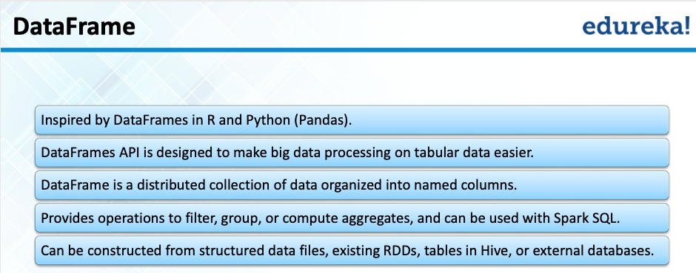
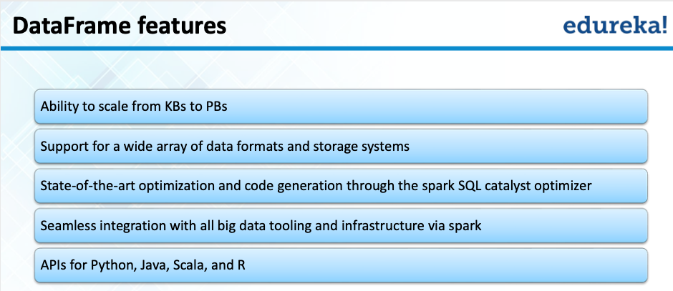
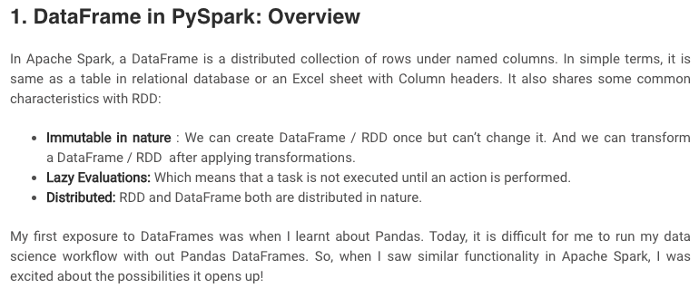
Spark/PySpark
https://www.analyticsvidhya.com/blog/2016/10/spark-dataframe-and-operations/

Slide 18
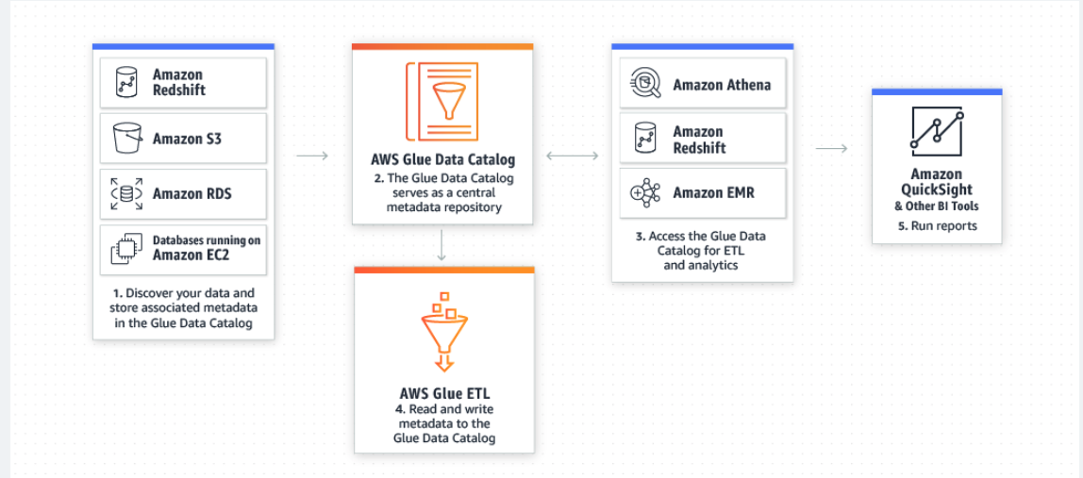
AWS Glue Supports Spark
AWS Glue is a serverless data preparation service that makes it easy for data engineers, extract, transform, and load (ETL) developers, data analysts, and data scientists to extract, clean, enrich, normalize, and load data.

Slide 19
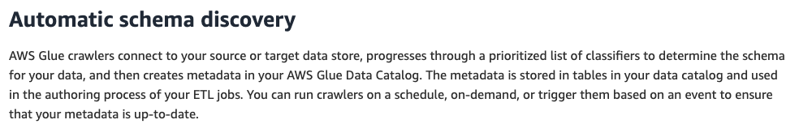
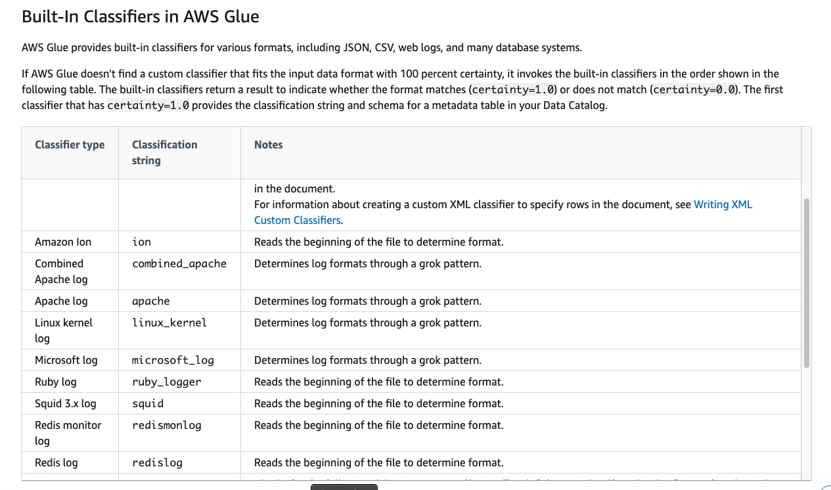
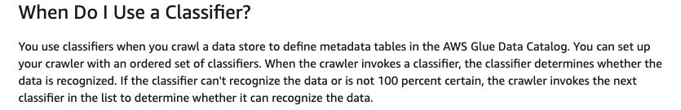
Crawlers/Classifiers

Slide 20
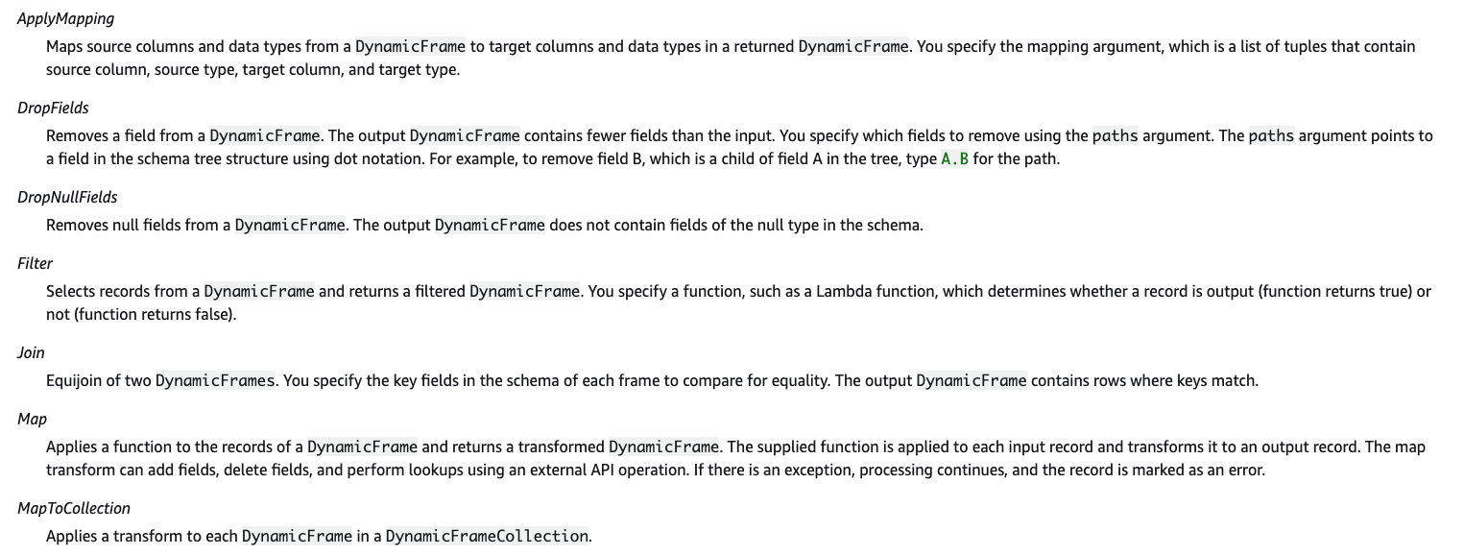
Built-In Transforms

Slide 21
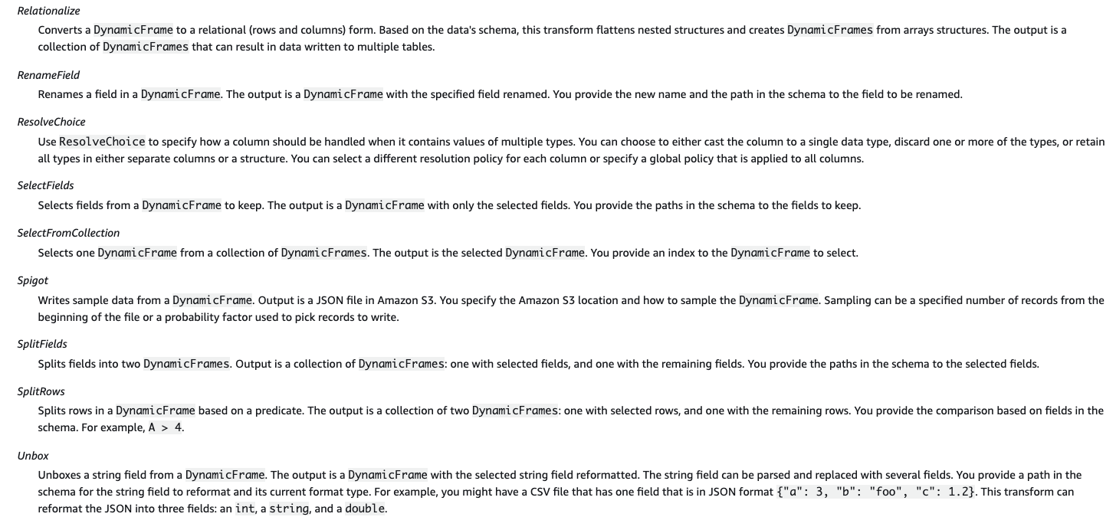
Built-In Transforms

Slide 22
Some Examples
(There are many, many online)
22 | Introduction to Databases (F20): Lecture 12 – Big Data and Analytics

Slide 23
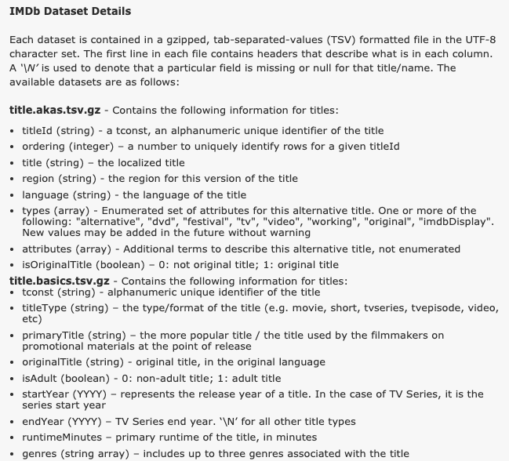
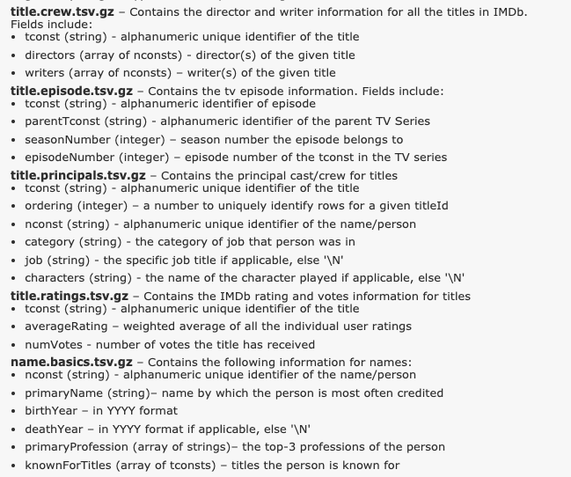
Let’s Load some IMDB Data

Slide 24
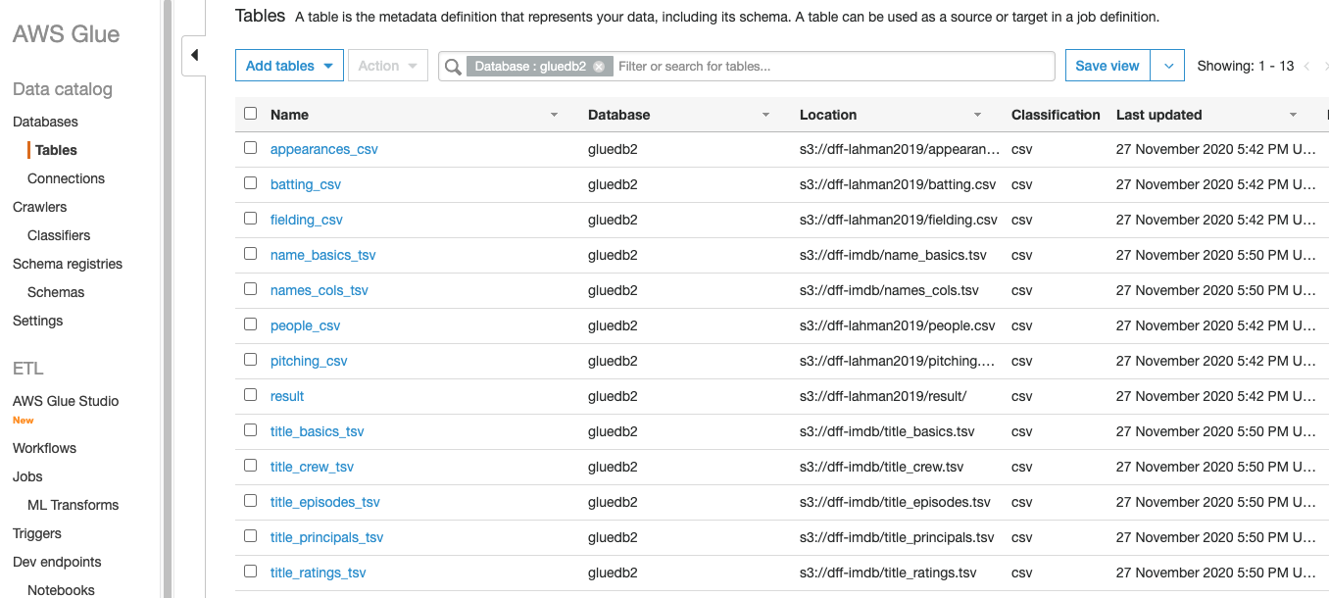
Let’s Load some IMDB Data
Downloaded CSV, gzipped TSV files.
Uploaded to S3.
Configured and launched crawler.
Discovered and categorized the data.

Slide 25
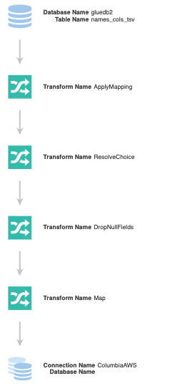
Extract – Transform – Load Glue Job
Extract based on metadata (format, location, ... ...)
Map the column names in the data to some other, better names.
What to do if the types in a column are ambiguous?
Get rid of any empty rows.
Custom map: Converts “\N” into None (Null)
Load MySQL RDS database on AWS.

Slide 26
Extract – Transform – Load
Extract based on metadata (format, location, ... ...)
Map the column names in the data to some other, better names.
What to do if the types in a column are ambiguous?
Get rid of any empty rows.
Custom map: Converts “\N” into None (Null)
Load MySQL RDS database
Consider converting “\N” into NULL:
Basically, update names set birthyear=None where birthyear=“\\N”
I can partition the table into multiple, smaller tables.
Run the operation in parallel on each smaller table.
Concatenate each smaller table to reform the larger, table which is unordered.
This pipelines is parallelizable:
Partition file into chunks.
Run the pipeline on each chunk.
Parallel write into DB.

Slide 27
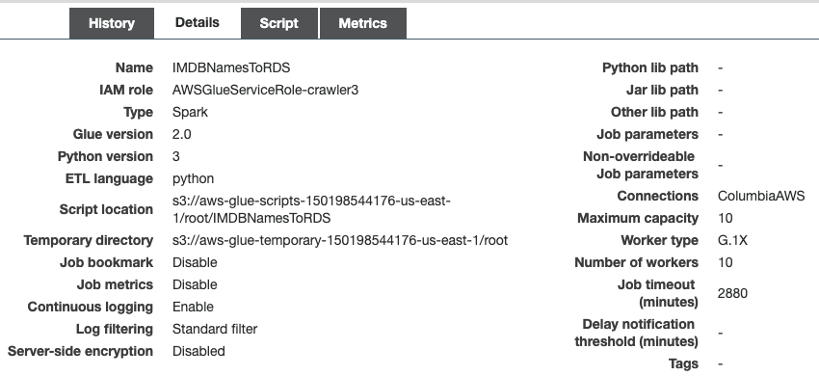
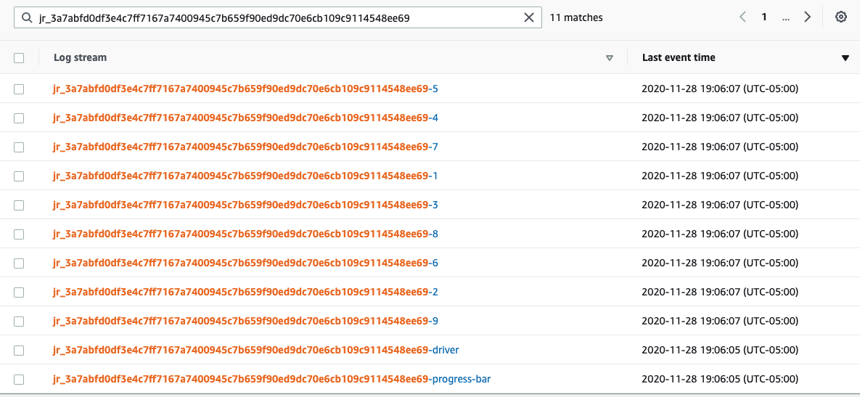
Extract – Transform – Load
One driver/controller.
10 workers.

Slide 28
Extract – Transform – Load
Extract based on metadata (format, location, ... ...)
Map the column names in the data to some other, better names.
What to do if the types in a column are ambiguous?
Get rid of any empty rows.
Custom map: Converts “\N” into None (Null)
Load MySQL RDS database
Let’s look at the code.
PySpark Job
MySQL data
MySQL Query

Slide 29
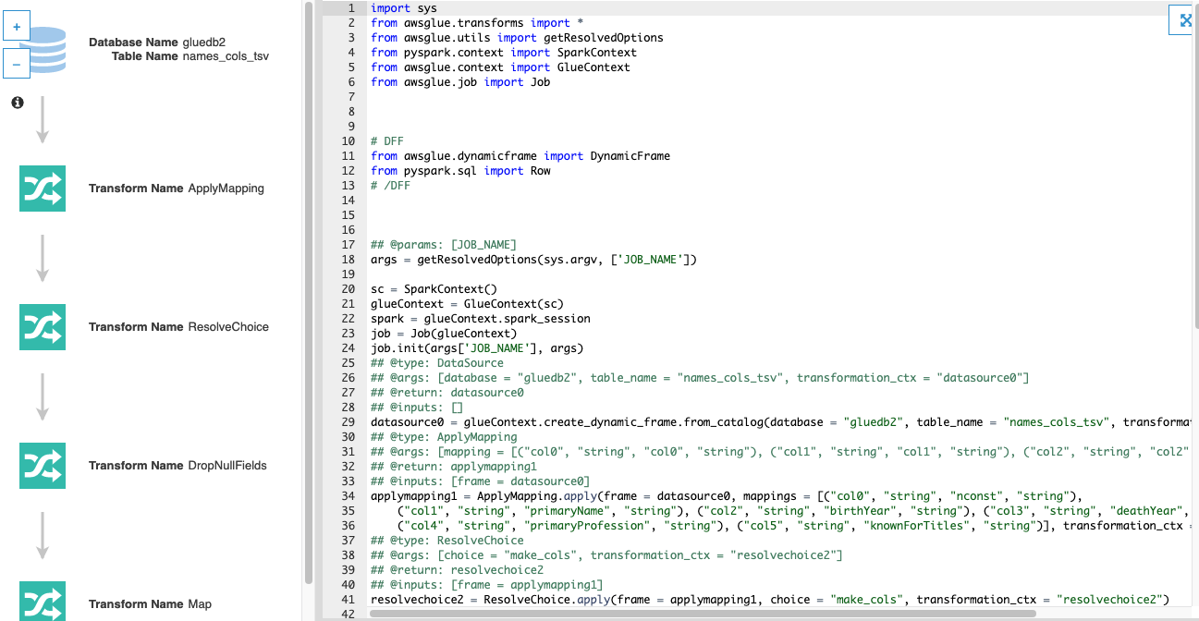
Jobs/Script
Not the greatest code you will every see
But, ... ...
That should not surprise you by now.
Since the model is algebraic and extensible,
It enables developing higher level tools.

Slide 30
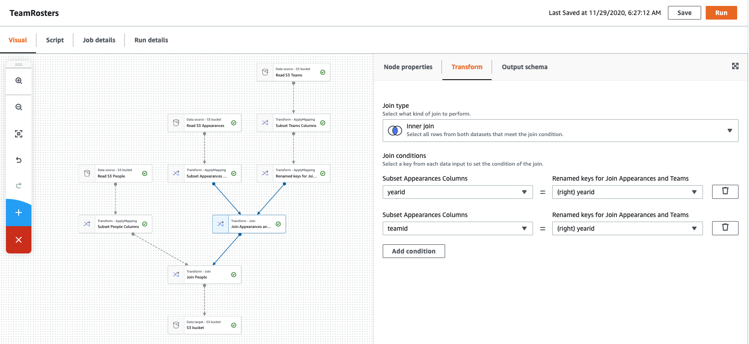
Visual Tools (There are similar tools for SQL, ETL, ... ...)

Slide 31
Putting Some Pieces Together
31 | Introduction to Databases (F20): Lecture 12 – Big Data and Analytics

Slide 32
What is the S3 of Which You Speak?
We have focused on “databases” in this course.
Databases and other programs are applications on storage systems, e.g. disks, network addressable storage, storage area networks.
The “cloud” provides internet accessible storage systems:
Block storage is like a disk space with (logical block ID, block data).
Object storage is (key, BLOB), aka (URL, BLOB)
MySQL RDS runs in a VM in EC2. The VM uses EBS for the disk block system.

Slide 33
AWS Simple Stored Services (S3)

Slide 34
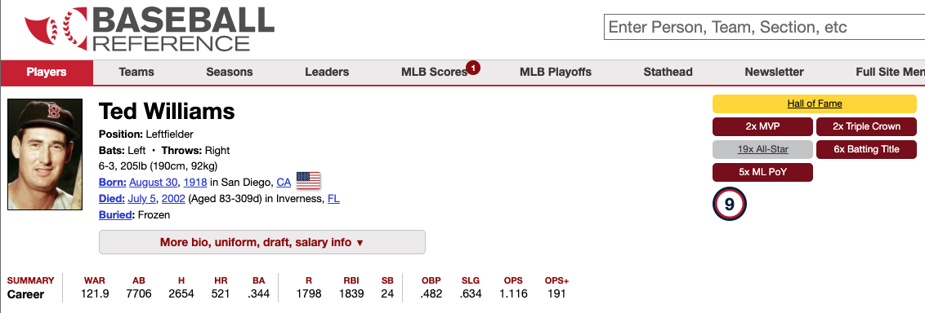
How Do You Make a Page Like This?

Slide 35
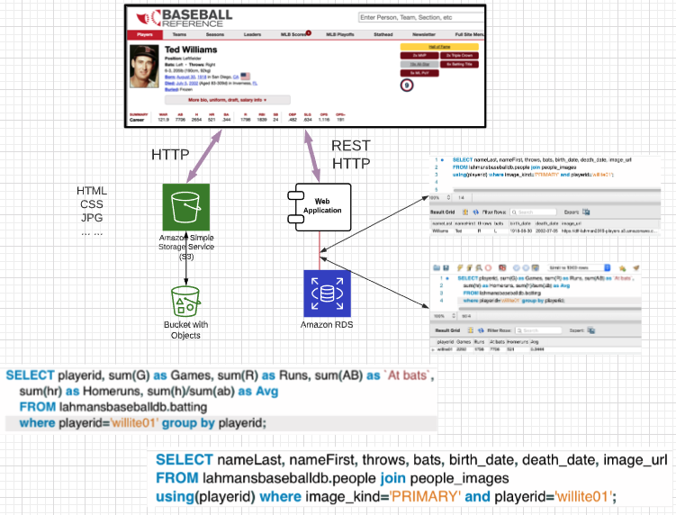
How Do You Make a Page Like This?
We talked about how the web is like a database of resources.
GET /players?nameLast=
GET /players/willite01
GET /career_batting/willite01
... ...
Web application:
Converts REST calls into
SQL statements
Returns data to browser.
Browser uses HTTP to get hyperlinked documents.

